Slide 1

ACCIDENT SEVERITY
CAPSTONE FINAL PROJECT

Slide 2
INTRODUCTION
DATA
METHODOLOGY
RESULT AND DISSCUSSION
CONTENT

Slide 3
introduction

Slide 4
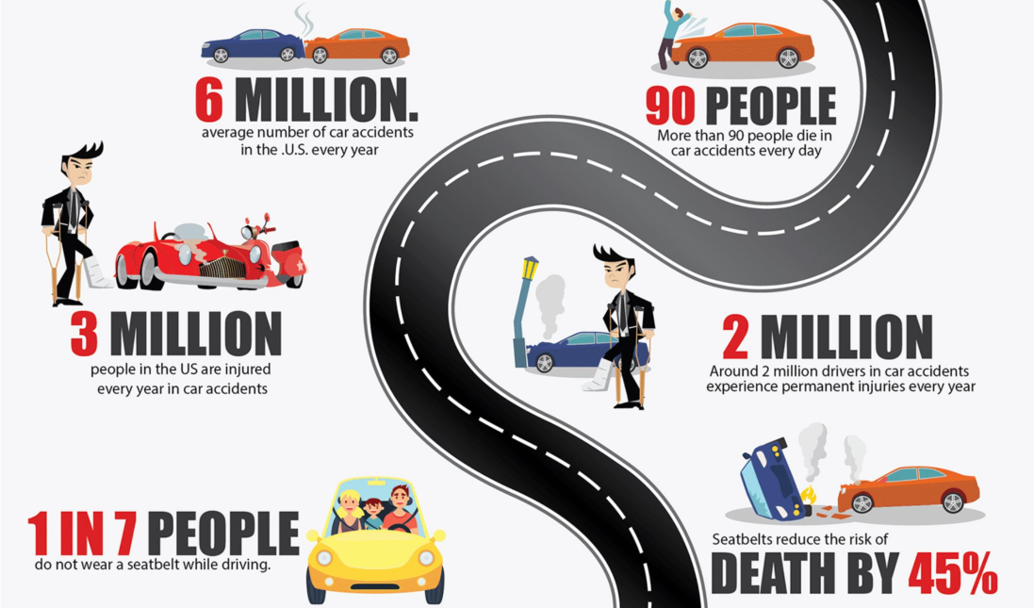
1. INTRODUCTION

Slide 5
How to Improve Road Safety?
1. INTRODUCTION
MACHINE LEARNING TO PREDICT THE LIKELIHOOD OF SEVERE TRAFFIC ACCIDENTS, THEREBY WARNING DRIVERS OF THE DANGERS
PREDICT SEVERITY OF ACCIDENTS COULD HELP MEDICAL FACILITIES PREPARE IN ADVANCE SO AS TO DECREASE FATALITIES
Better awareness
Fewer fatalities
Less work for police

Slide 6
data

Slide 7
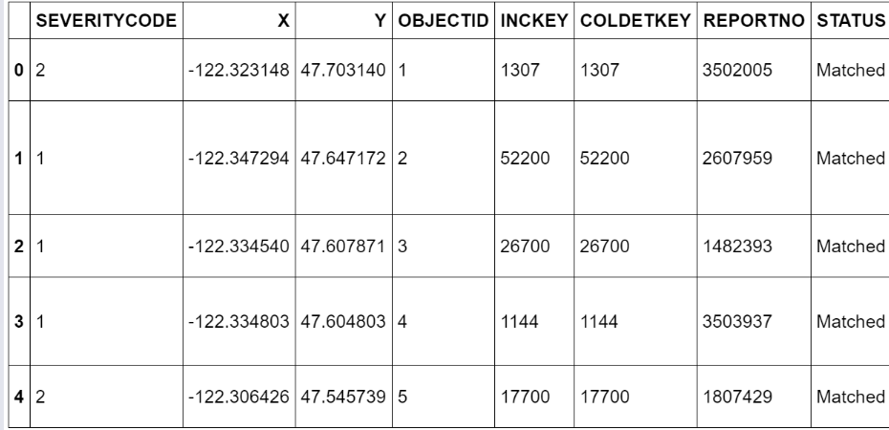
DATA
Data Source
Seattle Department of Transportation (SDOT). Updated weekly, from 2004 to present.
Email: DOT_IT_GIS@seattle.gov
Metadata
The raw dataset contains 38 columns and 194673 row. Except the first column being the label, all other 37 columns are features.
Complete metadata: click here.

Slide 8
methodology

Slide 9
Eliminating Bias
Data Processing
Raw data contains far more instances of SEVERITYCODE 1 than of 2 (around 2.34:1)
Uses dataframe.sample() method to sample from SEVERITYCODE==1 instances an amount equal to the number of SEVERITYCODE==2 instances
Balanced data
Bias eliminated
Better training

Slide 10
Which features affect the SEVERITYCODE?
EXPLORATORY DATA ANALYSIS
Dataframe.groupby(feature_name)[].value_counts() is used on each column to determine the ones correlated with accident severity
Converts INCDATE to data objects and then to day of the week, but finds no correlation with SEVERITYCODE
Which features
WHY THESE FEATURES
TO BE ONE-HOT ENCODED

Slide 11
How could categorical features be used to train the model?
ONE HOT ENCODING
Dataframe(feature_name).replace() was used on each feature to convert categorical variables into numerical ones
Test the post-processing dataset with dataframe.dtypes to double check
Numerical values
Ready for training
Decreased complexicty

Slide 12
How could features on different scales be used without bias?
Feature Selection And Normalization
Selects 14 features from dataset, including weather, road condition, lighting, etc.
Uses dataframe.dropna() to drop rows of the feature set with NaN values and preprocessing.StandardScalar().fit().transform() to normalize the feature set.
No empty cells
Without bias
Ready for training

Slide 13
How to train the ML models with existing data and test them?
Model Training and Testing
Uses the train_test_split() method to split the datasets into X_train, y_train, X_test, y_test.
Imports four ML classification models (KNN, Decision Tree, SVM, and Logistics Regressioin, trains them with X_train and Y_train, and tests them with X_test and y_test to obtain their performance.
Models trained
Models tested
Performance obtained

Slide 14
Result and disscussion

Slide 15
Results and Discussion
KNN
Decision Tree
SVM
Logistic Regression
Accuracy Score: 0.694
K=25, consumes the most computing time
0.702
Max_depth=15, consumes little computing time
0.692
Kernel = ‘rbt’ , took much computing time
0.659
C = 0,1, took moderate computing time

Slide 16
Results and Discussion
Deployment
Improvement
Lesson Learned
Model Selection
With the least computing time and the most accurate result, decision tree will be selected for deployment
Preparing data, rather than training the models, takes the most time
Fine tune the parameters of the ML models so that better results could be predicted
After the model is deployed, it should be continually updated with newly-generated data for better performance

